Slide 1
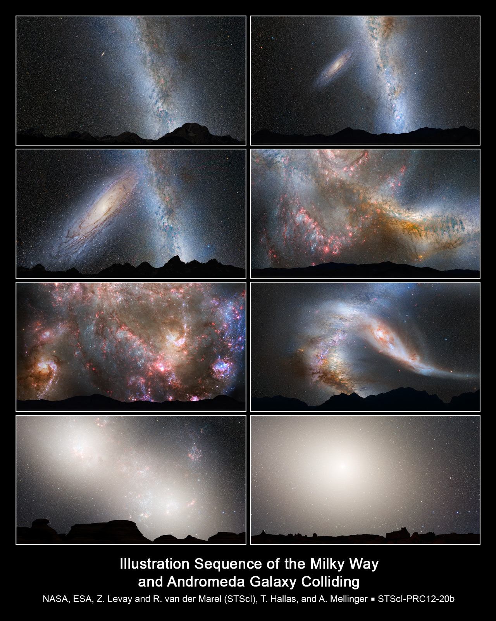
Are we all doomed? A model of global warming
Louis Beucher, Livia Eichmeyer, Nyan Raess, Trystan Coveney
[1] – Don’t worry, this is still 4.5 billion years away!

Slide 2
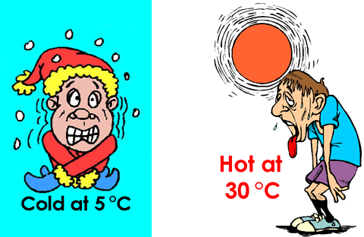
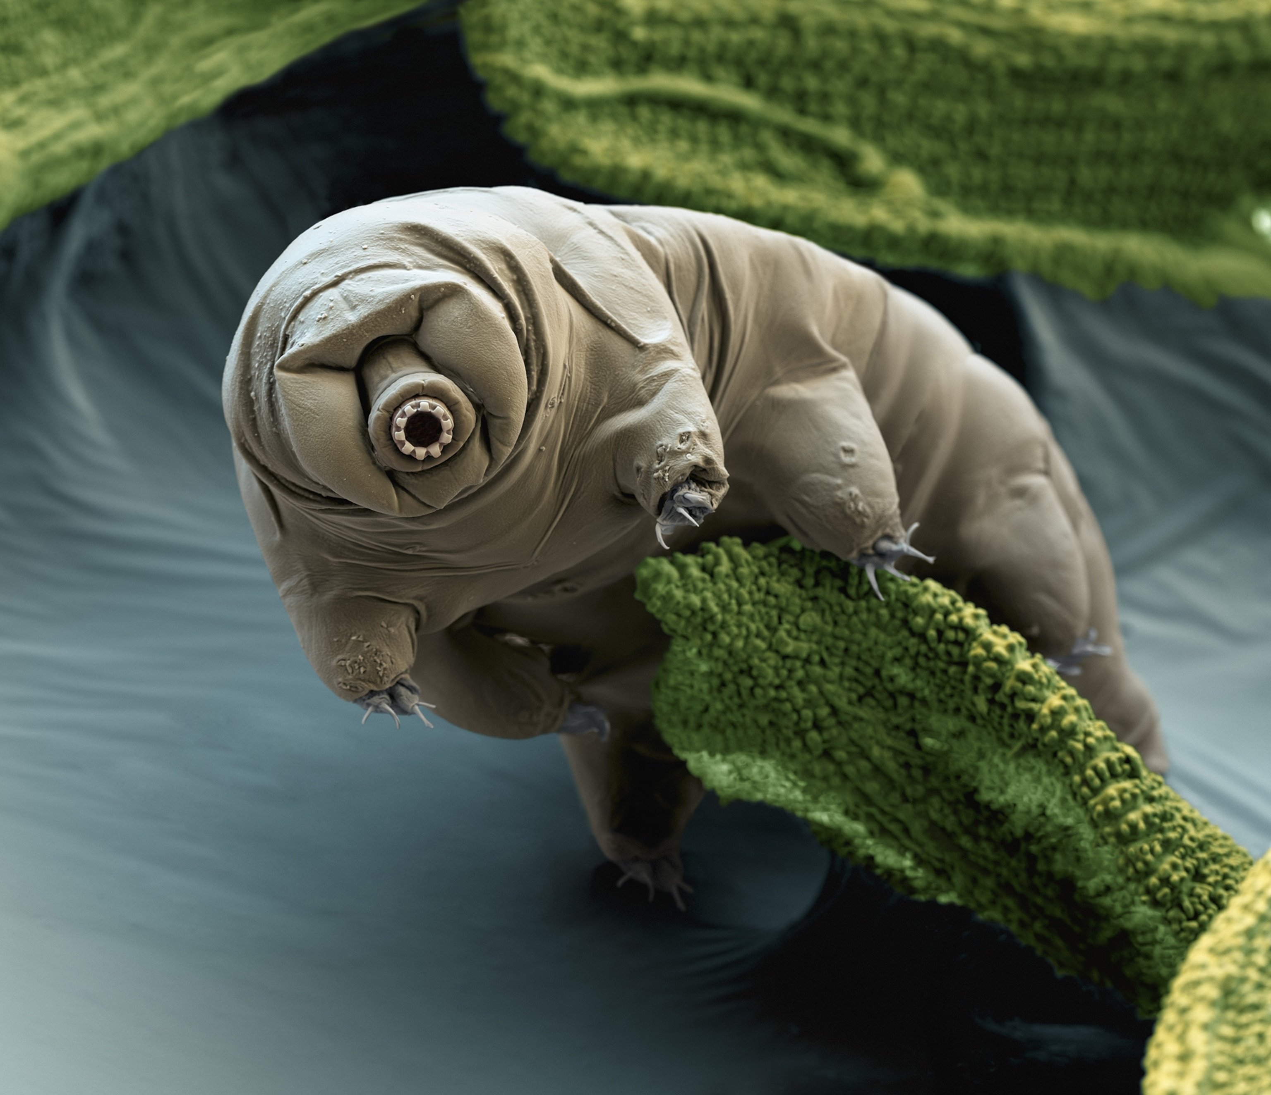
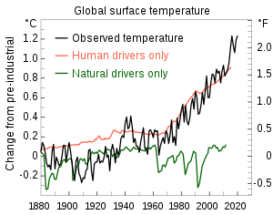
Climate Change: Why it matters
[3] The Human
[2] The Tardigrade (water/moss bear)
[4] The Planet

Slide 3
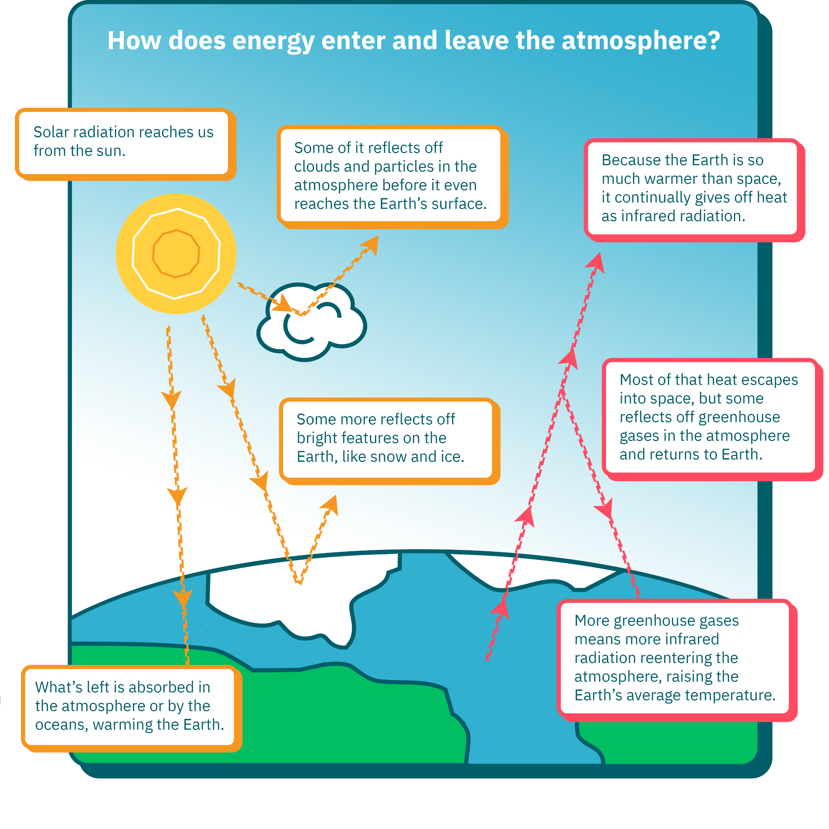
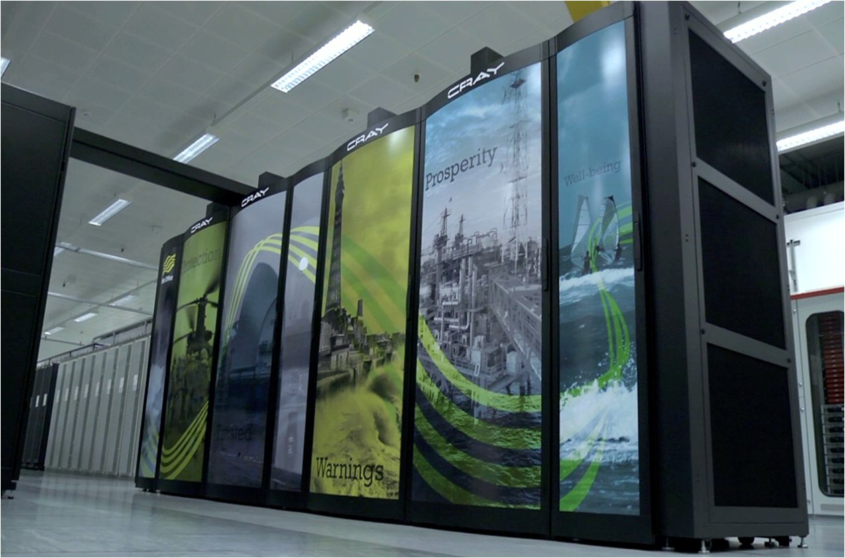
Climate Change: Why Is It Happening?
[5] The Met Office’s Cray XC40 supercomputing systems
[6] A simpler climate model

Slide 4
References
[1] https://earthsky.org/astronomy-essentials/earths-night-sky-milky-way-andromeda-merge/
[2] https://www.sciencemag.org/news/2021/05/hardy-water-bears-survive-bullet-impacts-point
[3] https://thinkmetric.uk/basics/temperature/
[4] USGCRP Chapter 3 2017 Figure 3.1 panel 2, Figure 3.3 panel 5.
[5] https://www.metoffice.gov.uk/about-us/what/technology/supercomputer
[6] https://climate.mit.edu/explainers/radiative-forcing
[7]

